Slide 1
Developing marketing strategies & plans

Slide 2
Contents
Marketing & customer value
Corporate & division strategic planning
Business unit strategic planning
Product planning- the nature & contents of a marketing plan

Slide 3
MARKETING & CUSTOMER VALUE
VALUE DELIVERY PROCESS
Assessing market opportunities & customer value
Choosing the value
Designing value
Delivering value
Communicating value

Slide 4
The value creation & delivery process begins much before there is a product/service & continues through development & after launch.
Assessing market opportunities & customer value, which involves environment scanning & developing insights about customer needs, wants, & motives.
Choosing the value includes critical decisions pertaining to segmenting, targeting, positioning, & branding, which is the essence of strategic marketing.
Designing value relates to decisions involving product/service strategy, new offerings, & pricing.
Delivery value focuses on distribution & access issues.
Communicating value through integrated marketing communication, choosing among the various choices in mass & personalized media.
The value so created needs to be grown & sustained through globalization & holistic marketing organization.

Slide 5
Value chain
Value chain proposed by Harvard’s Michael Porter is a tool for identifying ways to create more customer value. According to this model, every firm is a synthesis of activities performed to design, produce, market, deliver, & support its product.
The value chain identifies nine strategically relevant activities- five primary & four support activities.
Primary activities:
Inbound logistics, or bringing material into business
Operations, or converting materials into final products
Outbound logistics, or shipping out final products
Marketing, which includes sales
Service

Slide 6
Support activities:
Procurement
Technology development
Human resource management
Firm infrastructure
The firms success depends not only on how well each department performs its work, but also on how well the company coordinates departmental activities to conduct core business processes.
Processes include:
The market-sensing process
The new-offering realization process
The customer acquisition process
The customer relationship management process
The fulfillment management process
E.g. – Maruti Suzuki India ltd. engages with its suppliers on an ongoing basis to keep them abreast of the global quality levels

Slide 7
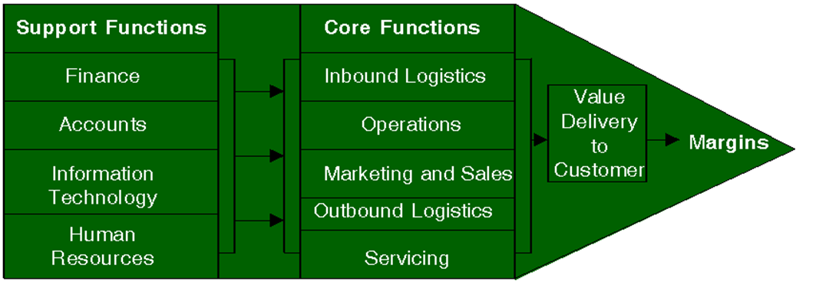

Slide 8
Core competencies
A core competencies has 3 characteristics:
It is a source of competitive advantage & makes a significant contribution to perceived customer benefits.
It has applications in wide variety of markets.
It is difficult for competitors to imitate.
Business realignment may be necessary to maximize core competencies.
It has 3 steps:
Redefining the business concept or “big idea”
Reshaping the business scope
Repositioning the company’s brand identity.
E.g.- Godrej & Boyce realigned its furniture business to target the home segment, with successful results.

Slide 9
Holistic marketing orientation & customer value
Holistic marketing is “integrating the value exploration, value creation, & value delivery activities with the purpose of building long term, mutually satisfying relationships & coprosperity among key stakeholders.”
Holistic marketers address 3 key management questions:
Value exploration- how a company identifies new value opportunities.
Value creation- how a company efficiently creates more promising new value offerings
Value delivery- how a company uses its capabilities & infrastructure to deliver the new value offerings more efficiently.

Slide 10
The central role of strategic planning
To ensure customers select & execute the right activities, marketers must give priority to strategic planning in three key areas:
Managing a company’s business as an investment portfolio
Assessing each business’s strength by considering the market’s growth rate & the company’s position & fit in that market
Establishing a strategy.
Examples of some reputed marketers who focus on customer & are organized to respond effectively to changing customer needs:
Amazon.com, Axis bank, BMW, Google, Honda, Nokia, P&G, Samsung, Sony, Tata, Walmart.

Slide 11
The strategic planning, implementation, & control processes
Planning
Corporate planning
Implementing
Organizing
Controlling
Measuring results
Division planning
Business planning
Product planning
implementing
Diagnosing results
Take corrective action

Slide 12
CORPORATE & DIVISION STRATEGIC PLANNING
Strategic market planning (also mentioned as Strategic Planning or Strategic Market-Oriented Planning, or Strategic Marketing Planning in some texts) essentially refers to planning that is conceptually and functionally long-term, typically covering a period of five years or more for the entire corporation. Strategic market planning is a process yielding a marketing strategy that is the framework for a marketing plan.

Slide 13
Corporate Mission
Opportunities Objectives Resources
Corporate & SBU Strategy
Marketing Objectives
Marketing Strategies
Selection & Analysis of Target Markets
Marketing Mix Decisions
Elements of Strategic Market Planning

Slide 14
All corporate headquarters undertake four planning activities:
Defining the corporate mission
Establishing strategic business units
Assigning resources to each strategic business unit
Assessing growth opportunities

Slide 15
Defining the corporate mission
Organization develop mission statements to share with managers, employees, & customers. A clear, thoughtful mission statement provides a shared sense of purpose, direction, & opportunity.
Good mission statements have five major characteristics:
They focus on a limited number of goals
They stress the company’s major policies & values
They define the major competitive spheres within which the company will operate.
They take a long term view
They are as short, memorable, & meaningful as possible.

Slide 16

Examples of some companies mission & vision
Nestle
Mission
Their mission is to provide consumers with the best tasting, most nutritious choices in a wide range of food & beverage categories & Eating occasions, from morning to night.
VISION
“To rapidly build nestle India as the respected & trustworthy leading food, nutrition, health, & wellness company ensuring long term sustainable & profitable growth”
NESTLE
GOOD
FOOD
GOOD
LIFE

Slide 17

INDIGO AIRLINES
MISSION
Indigo airlines mission is passenger's safety.
VISION
IndiGo to go ahead with fleet expansion.
To be the best airline in India by providing the following values to the customer:
Affordable fairs
Ontime performance
Hasslefree service

Slide 18

SAMSUNG
MISSION
EVERYTHING WE DO AT SAMSUNG IS GUIDED BY OUR MISSION: TO BE THE BEST “DIGITAL-E-COMPANY”.
TO BE THE BEST DIGITAL-E-COMPANY
DIGITAL
TO CREATE TECHNOLOGY PRODUCTS & SERVICES THAT LEAD THE INDUSTRY
E
TO PUT INTO PLACE THE MOST EFFICIENT MANAGEMENT & PRODUCTION PROCESSES
COMPANY
TO MAINTAIN A STEADFAST FOCUS ON STRENGTHENING OUR ORGANISATION, ON CONTINUTY TO BE A GLOBAL TECHNOLOGY LEADER & TRUSTED RESPONSIBLE COMPANY

Slide 19
VISION
“INSPIRE THE WORLD, CREATE THE FUTURE”
SAMSUNG COMMITMENT IS TO INSPIRE ITS COMMUNITIES BY TAKING ADVANTAGE OF ITS KEY STRENGTH, CREATIVE SOLUTIONS, INNOVATIVE PRODUCTS & NEW TECHNOLOGY. THIS INCLUDES INDUSTRY, PARTNERS & EMPLOYEES. SAMSUNG ALSO HAS A LAN TO REACH $400 BILLION IN REVENUE & BE CLASSIFIED AS WORLDS TOP FIVE BRANDS BY 2020.
INDUSTRY
VISION
EMPLOYEE
VISION
PARTNER VISION
VISION
2020

Slide 20
Establishing Strategic Business Units(SBUs)
“A Strategic Unit may be a division, a profit Centre, a product line or a number of related products, and in some cases a single product”.
An SBU has three characteristics:
It is a single process, or a collection of related businesses, that can be planned separately from the rest of the company
It has its own set of competitors
It has a manager responsible for strategic planning & profit performance, who controls most of the factor affecting profit.

Slide 21
Assigning resources to each SBU
Once it has defined SBU’s, management must decide how to allocate corporate resources to each. Several portfolio-planning models provide ways to make investment decisions that have fallen out of favor as oversimplified & subjective. Newer methods rely on shareholder value analysis, & on whether the market value of a company is greater with an SBU or without it.
Assessing growth opportunities
Assessing growth opportunities includes planning new businesses. If there is a gap between future desired sales & projected sales, corporate management will need to develop or acquire new businesses to fill it.
The first option is to identify opportunities for growth within current businesses (intensive opportunities). The second is to identify opportunities to build or acquire businesses related to current businesses ( integrative opportunities). The third is to identify opportunities to add attractive unrelated businesses (diversification opportunities).

Slide 22
Boston Consulting Group (BCG) Approach
Growth-Share Matrix developed by Boston Consulting Group

Slide 23
Growth Strategies
Intensive Growth: Intensive growth strategies are appropriate when current products and current markets show the potential for sales increase. There are three main strategic options that seem to be appropriate to accomplish intensive growth:
1. Market Penetration.
2. Market development.
3. Product development.
PRODUCT
Current New
Current Market Product penetration development
MARKET
Market Diversification New development
Growth Strategies

Slide 24
Diversification Growth
This strategy involves developing new products to be sold in new markets.
Markets
Present Markets New Markets
Unrelated to Horizontal Conglomerate Current Products diversification diversification
New Products
Integrated Concentric Related to diversification Current Products
diversification
Diversification Strategies

Slide 25
Organization & Organizational Culture
A company’s organization consists of its structures, policies, & corporate culture, all of which can become dysfunctional in a rapidly changing business environment.
Corporate culture is defined as “ the shared experiences, stories, beliefs, & norms that characterize an organization.”
Marketing innovation
Innovation in marketing is critical. Imaginative ideas on strategy exist in many places within a company. Senior manager should identify & encourage fresh ideas from three underrepresented groups:
Employees with youthful or diverse perspectives, employees far removed from company headquarters, & employees new to the industry.
Each group can challenge company orthodoxy & stimulate new ideas.

Slide 26
BUSINESS UNIT STRATEGIC PLANNING The business unit strategic-planning process
Goal formulation
Strategy formulation
Program formulation
BUSINESS MISSION
External environment (opportunity & threat analysis)
Internal environment(strength/ weakness analysis)
implementation
Feedback & control
SWOT Analysis

Slide 27
BUSINESS MISSION
Each business units needs to define its specific mission within the broader company mission.
Focus on limited number of goals
Stress major policies and values
Define major competitive spheres
SWOT ANALYSIS
An important exercise undertaken by many businesses at this level is to conduct strengths, weaknesses, opportunities and threats (SWOT) analysis to spot the right opportunities to match the business unit’s strengths and also identify weaknesses and serious threats and their likelihood of occurrence that may hamper the business unit’s growth prospects.
It’s a way of monitoring the external & internal marketing environment.

Slide 28
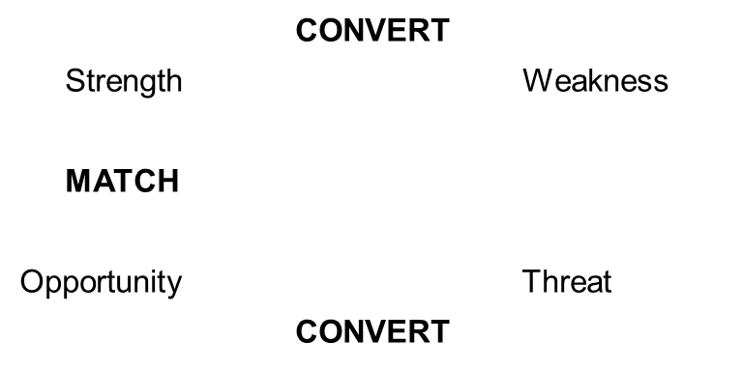
FOUR CELL SQUARE MATRIX
GOAL FORMULATION & MBO
Requirements for using Management by Objectives (MBO)
Unit’s objectives must be hierarchical
Objectives should be quantitative
Goals should be realistic
Objectives must be consistent

Slide 29
STRATEGY FORMULATION
Porter’s Generic Strategies
High Lower Cost Cost Leadership
Focus or Differentiation
Differentiation
Competitive
Advantage
No Differentiation
No Cost Leadership
No Focus
Low
Narrow
Broad
Target
Competitive Scope
Target
Porter’s Generic Strategies Model

Slide 30
Michael Porter has proposed three strategies that provide starting points for strategic thinking:
Cost leadership
The company targets a broad market and aims to become the lowest-cost producer of a standard product and produces large quantities, then prices it at a level that is less than the competitors’ prices.
Differentiation
Strategy of differentiation involves developing a competitive advantage by offering a product that has broad appeal because, the product is perceived as persuasively valuable and distinct by customers, perhaps even unique in some way such as quality, innovative design, emotional dimensions, service, etc.
Focus
Focus strategy refers to accomplishing a competitive advantage in a part of market to satisfy customer needs either through cost leadership or differentiation by offering a low-priced product or a high-priced but highly distinctive product.

Slide 31
Strategic alliances
Product or Service Alliances
Promotional Alliances
Logistics Alliances
Pricing collaborations
PROGRAM FORMULATION & IMPLEMENTATION
Even a great marketing strategy can be sabotaged by poor implementation. If the unit has decided to attain technological leadership, it must strengthen its R&D department, gather technological intelligence, develop leading edge products, train its technical sales force, & communicate its technological leadership.

Slide 32
FEEDBACK & CONTROL
A company’s strategic fit with the environment will inevitably erode, because the market environment changes faster than the company’s seven Ss. Thus, a company might remain efficient yet lose effectiveness.
Once an organization fails respond to a changed environment, it becomes increasingly hard to recapture its lost position.
The key to organizational health is the willingness to examine the changing environment & adopt new goals & behaviors.

Slide 33
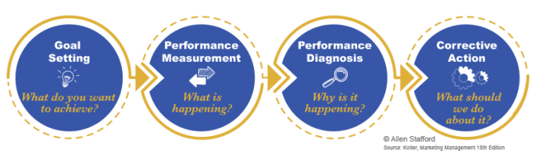
The Control process

Slide 34
Marketing Objectives and Strategy
Marketing objectives are determined on the basis of current business analysis and specify what is to be accomplished through marketing activities.
Marketing strategy refers to actions for developing, pricing, distributing, and promoting products that meet the needs of specific customer groups.

Slide 35
Developing Marketing Plan
A marketing plan is a formal written document, prepared detailing the activities essential to implement the chosen marketing strategies.
In other words, a marketing plan is a written document that summarizes what the marketer has learned about the marketplace & indicates how the firm plans to reach its marketing objectives.
CONTENTS OF A MARKETING PLAN
Executive summary
Table of contents
Situation analysis
Marketing strategy
Financial projections
Implementation controls

